Slide 1
Fourier Series Estimator in Semiparametric Regression to Predict Criminal Rate in Indonesia
Presenter : Belindha Ayu Ardhani
Corresponding Author : M. Fariz Fadillah Mardianto
Department of Mathematics, Airlangga University, Surabaya, Indonesia
Co Authors : Rini Kustianingsih, Kuzairi, Amin Thohari, Raka Andriawan, Tony Yulianto

Slide 2

Introduction

Slide 3
Introduction Background of Research
This study focused on semiparametric regression, which used combination of linear estimator for parametric component and Fourier series estimator for nonparametric component.
It used to predict the percentage of criminal incidents in Indonesia based on factors that influence it related to the fact that criminal rate as one of big problems in Indonesia.
The determination of the use of semiparametric regression was based on relationships between percentage of criminal incidents and its influenced factors.
The relationship between percentage of criminal incidents and percentage of population showed parametric form. It was related to fact that the increase of population contributes to the increase of crime rate (Sheykhi, 2016). Both of them actually have upward trend every year. That was why they had parametric pattern.
In another hand, the relationship between percentage of criminal incidents and percentage of unemployed population; also relationship between percentage of criminal incidents and percentage of poor people showed nonparametric form. Both unemployed population and poor people have fluctuating percentage every year. That was why the relationships had nonparametric pattern.

Slide 4
Introduction Previous Research of Fourier Series
1
Bilodeau (1992) used Fourier cosine series as an estimator to make regression curve smoother.
2
Bilodeau’s research was developed by Mardianto et. al. (2019), whom used specific cases in nonparametric regression.
Semiparametric Regression
3
The optimal design for obtaining constraints in Fourier series estimator examined by Biedermann et. al. (2009), and Dette et. al. (2016). Both of them use Fourier series with sine and cosine basis.
Nonparametric Regression
4
Asrini and Budiantara (2014), who applied research of Pane et. al. (2014) in modelling of rice production in Central Java.

Slide 5
Literature Review

Slide 6
Semiparametric Regression and Fourier Series Estimator
Regression analysis is a method to analyze the pattern of functional relationships between two or more variables.
The main purpose of this method is to know the form of regression curve estimation.
There are three approaches to estimate regression curves, such as parametric regression, nonparametric regression, and semiparametric regression.
Fourier series is a trigonometric polynomial function that often be used in Mathematical and Statistical modeling. Fourier series estimators are used to describe the two curves of sine and cosine waves.
There are several forms of Fourier series in Mathematical study, such as cosine and sine base (general Fourier series); Fourier series of sine base; and Fourier series of cosine base.

Slide 7
Data and Procedures

Slide 8






Data and Research Variable
The data was taken from Badan Pusat Statistik (BPS) or Central Bureau of Statistics with data in 2018 used as training data for estimating curve regression, and data in 2019 used as testing data for predicting based on the selected Fourier series estimator.
$y$ : the percentage of criminal incidents
$x$ : the percentage of population
Research Variables
$t_{1}$: the percentage of unemployed population
$t_{2}$: the percentage of poor people
The method used is Fourier series estimator in semiparametric regression using Software R

Slide 9
Steps of Analysis
Identifying predictors that are included in parametric predictor and nonparametric predictor based on training data.
Calculating a prediction based on testing data.
Selecting the best Fourier series estimator in semiparametric regression after finishing step 3 until step 6 for all of Fourier series estimator.
Selecting an oscillation parameter based on the smallest GCV for $k=1,2,3,4,5$ (parsimonious model).
Selecting an oscillation parameter based on the smallest GCV for 𝑘=1,2,3,4,5 (parsimonious model).
Determining GCV value using equation (12) for $k=1,2,3,4,5$ for Fourier series estimator based on cosine and sine (general Fourier estimator); cosine and sine.
Determining GCV value using equation (12) for 𝑘=1,2,3,4,5 for Fourier series estimator based on cosine and sine (general Fourier estimator); cosine and sine.
Repeating step 2 and step 4 for the other Fourier series estimator. Then, Determining the other goodness-of-fit criteria, such as MSE and $R^{2}$.
Repeating step 2 and step 4 for the other Fourier series estimator. Then, Determining the other goodness-of-fit criteria, such as MSE and R^2.
Presenting plot between response data and estimator data for testing data.

Slide 10

Result and Discussion

Slide 11
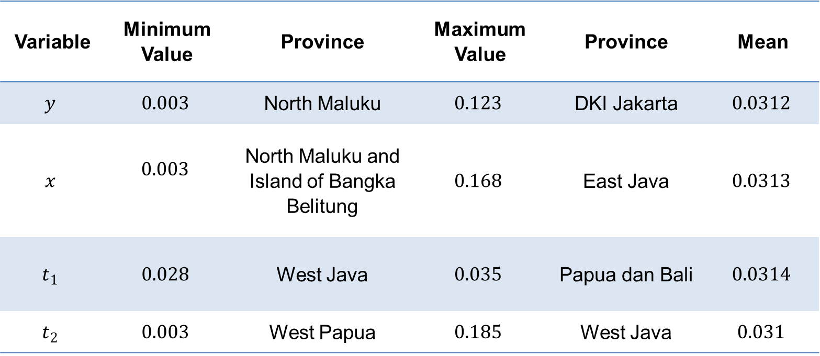
Descriptive Statistics
Variable | Minimum Value | Province | Maximum Value | Province | Mean
$$y$$ | $$0.003$$ | North Maluku | $$0.123$$ | DKI Jakarta | $$0.0312$$
$$x$$ | $$0.003$$ | North Maluku and Island of Bangka Belitung | $$0.168$$ | East Java | $$0.0313$$
$$t_{1}$$ | $$0.028$$ | West Java | $$0.035$$ | Papua dan Bali | $$0.0314$$
$$t_{2}$$ | $$0.003$$ | West Papua | $$0.185$$ | West Java | $$0.031$$

Slide 12
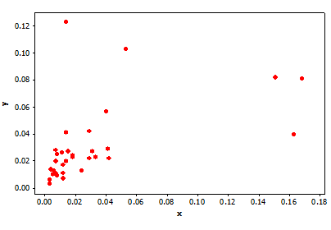
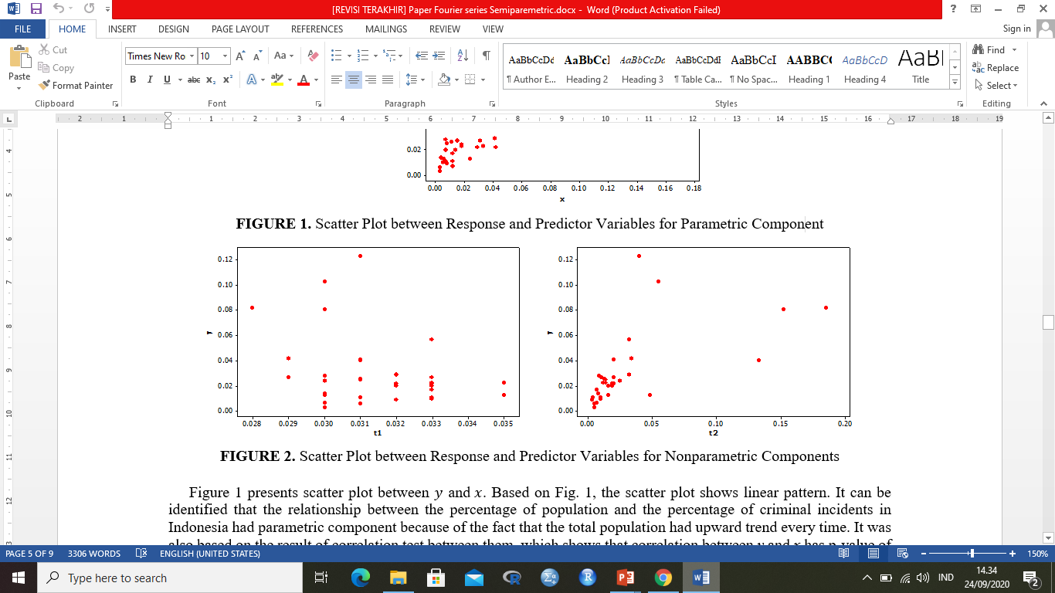
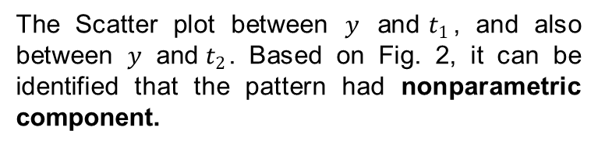
Plot of Relationships between Variables
Parametric Form
Nonparametric Form
The relationship between the percentage of population and the percentage of criminal incidents in Indonesia had parametric component. It was also based on the result of correlation test between them, which shows p-value of 0.047.
The Scatter plot between $y$ and${ t}_{1}$, and also between $y$ and${ t}_{2}$. Based on Fig. 2, it can be identified that the pattern had nonparametric component.

Slide 13
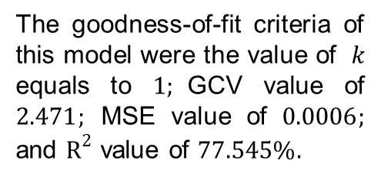
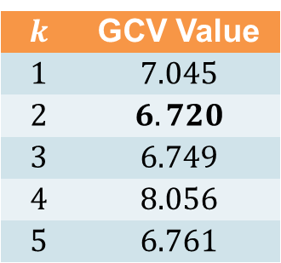
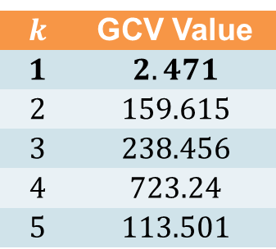
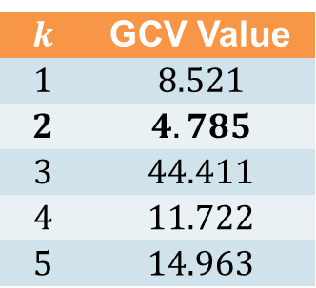
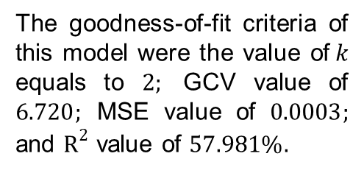
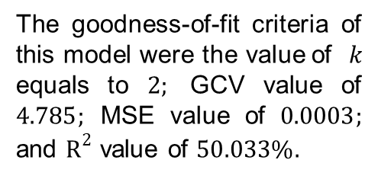
Data Analysis Based on Type of Fourier Series
Cosine Fourier Series
Sine Fourier Series
General Fourier Series
$$k$$ | GCV Value
$$1$$ | $$2.471$$
$$2$$ | $$159.615$$
$$3$$ | $$238.456$$
$$4$$ | $$723.24$$
$$5$$ | $$113.501$$
$$k$$ | GCV Value
$$1$$ | $$8.521$$
$$2$$ | $$4.785$$
$$3$$ | $$44.411$$
$$4$$ | $$11.722$$
$$5$$ | $$14.963$$
$$k$$ | GCV Value
$$1$$ | $$7.045$$
$$2$$ | $$6.720$$
$$3$$ | $$6.749$$
$$4$$ | $$8.056$$
$$5$$ | $$6.761$$
The goodness-of-fit criteria of this model were the value of $k$ equals to $1;$GCV value of $2.471;$ MSE value of $0.0006;$ and $R^{2}$ value of $77.545\%.$
The goodness-of-fit criteria of this model were the value of $k$ equals to $2;$ GCV value of $4.785;$ MSE value of $0.0003;$ and $R^{2}$ value of $50.033\%.$
The goodness-of-fit criteria of this model were the value of$k$ equals to $2;$ GCV value of $6.720;$ MSE value of $0.0003;$ and $R^{2}$ value of $57.981\%.$

Slide 14
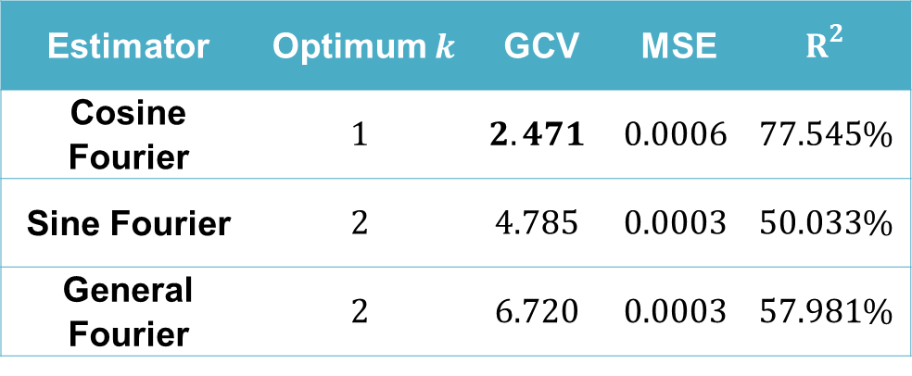
Best Fourier Series Estimator
Comparison with Sine, Cosine and General Base
Estimator | Optimum $k$ | GCV | MSE | $$R^{2}$$
Cosine Fourier | $$1$$ | $$2.471$$ | $$0.0006$$ | $$77.545\%$$
Sine Fourier | $$2$$ | $$4.785$$ | $$0.0003$$ | $$50.033\%$$
General Fourier | $$2$$ | $$6.720$$ | $$0.0003$$ | $$57.981\%$$
The estimator of cosine Fourier series was the most parsimony estimator. Based on the optimum oscillation parameter value, the estimator obtained can be presented as follows:
${\hat{y}}_{i}=−342.145−0.564x_{i1}+10.704t_{i1}+330.487\cos{t_{i1}}+1.982t_{i2}+12.113\cos{t_{i2}}$

Slide 15
Comparison of Predicted Value and the Actual Value of the Percentage of Criminal Incidents
Based on the calculation of error using Mean Absolute Error (MAE), the error value was 0.02. This value indicates that the use of semiparametric regression method with Fourier estimator can produce prediction, which is good enough.

Slide 16

Conclusion

Slide 17
Conclusion
Based on the analysis, the estimator result had satisfied goodness of criteria, such as minimum GCV value, minimum MSE value and high determination coefficient value for parsimony model. The analysis shows that the predicted value of the percentage of criminal incidents was getting closer value because it had the MAE value of 0,02.
This indicates that the model produced using semiparametric approach based on Fourier series estimator is suitable to predict the percentage of criminal incidents in Indonesia. For further research, the data can be applied based on nonparametric regression or the other estimator in semiparametric regression.

Slide 18
Thank you

